Slide 1
Add the Date dimension
to the model
Add the Date dimension
to the model

Slide 2
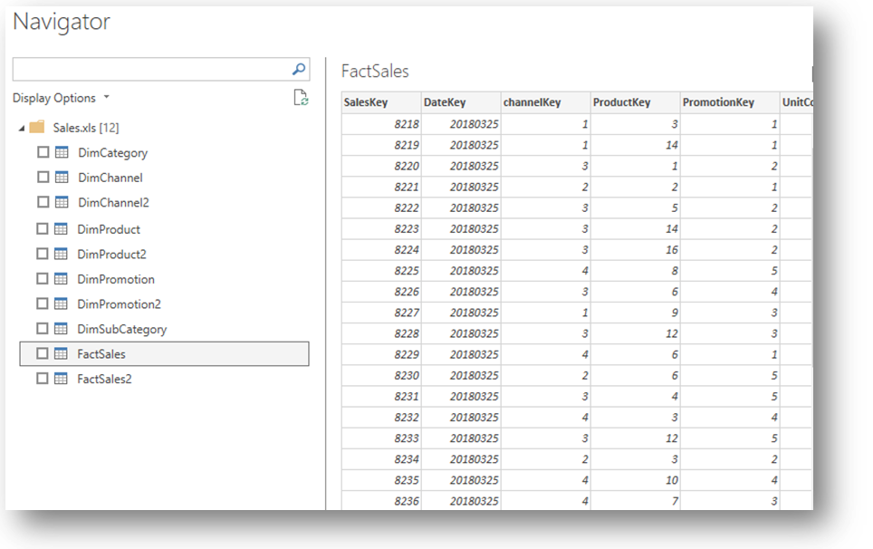
Add the date dimension to the model
Note: This workshop uses the Sales.xlsx file located in the Resources \Excel Sources folder
Select some dimensions as well as the "Fact Sales" table .

Slide 3
Add the date dimension to the model
Generate a "Date" dimension table.
Date =
VAR MinDate = DATE ( 2018,1,1 )​​​​
VAR MaxDate = DATE ( 2021 , 12 , 31 )
RETURN
ADDCOLUMNS (
CALENDAR ( MinDate , MaxDate ),
“Calendar Year” , “CY” & FORMAT ( [Date] , “YYYY” ),
"Month Name" , FORMAT ( [Date] , "MMMM" ),
"Month Number" , FORMAT ( [Date] , "MM" ),
"Date Key" , YEAR ( [Date] ) * 10000 + MONTH ( [Date] ) * 100 + DAY ( [Date] )
)

Slide 4
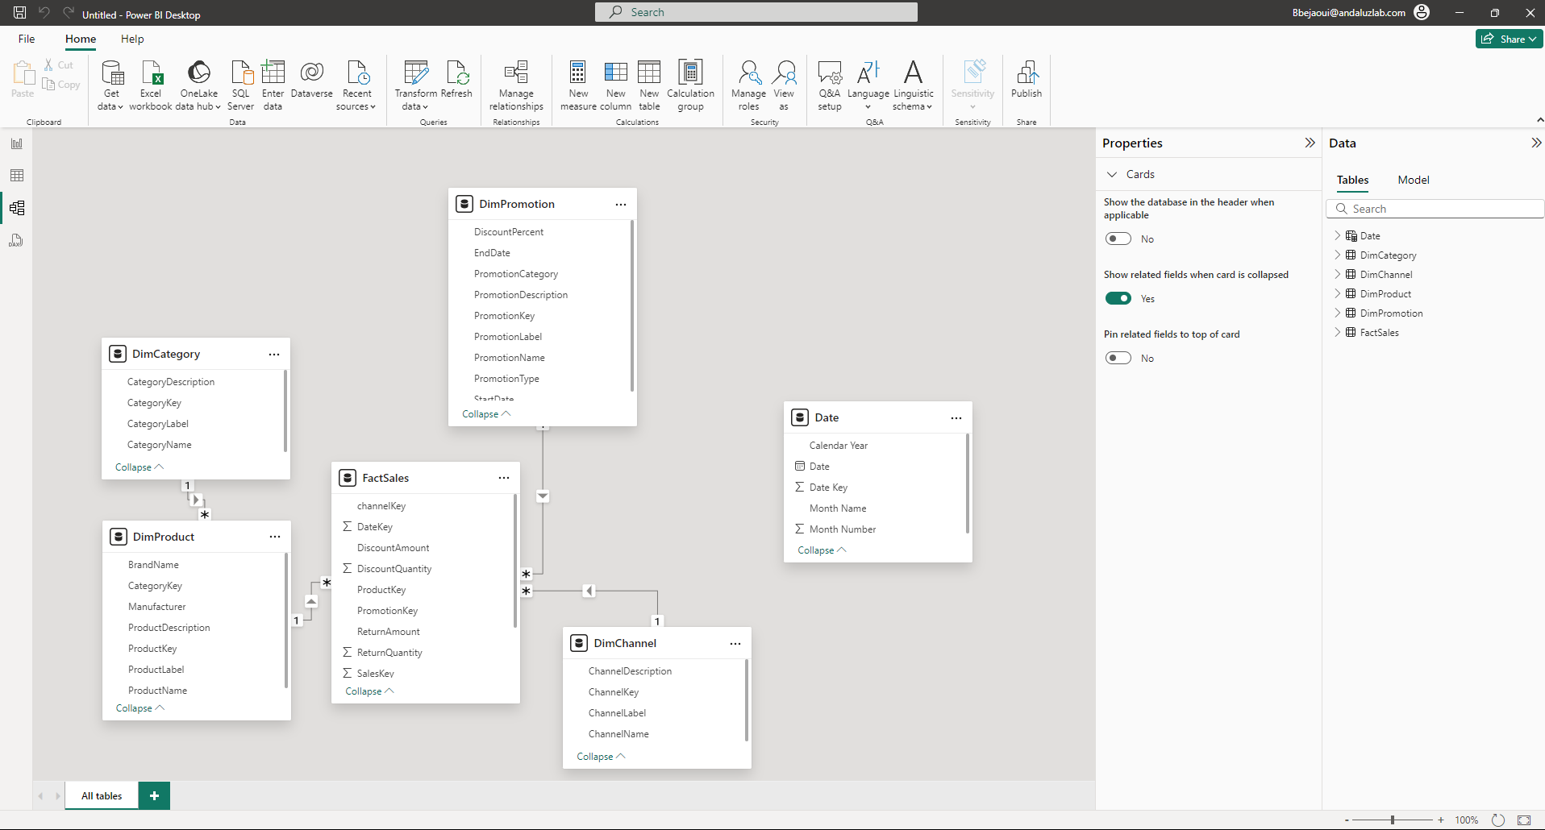
Add the date dimension to the model
Switch to Model View and drag and drop DimDate [ DateKey ] to FactSales [ DateKey ] .

Slide 5
THANKS
THANKS

